Slide 1
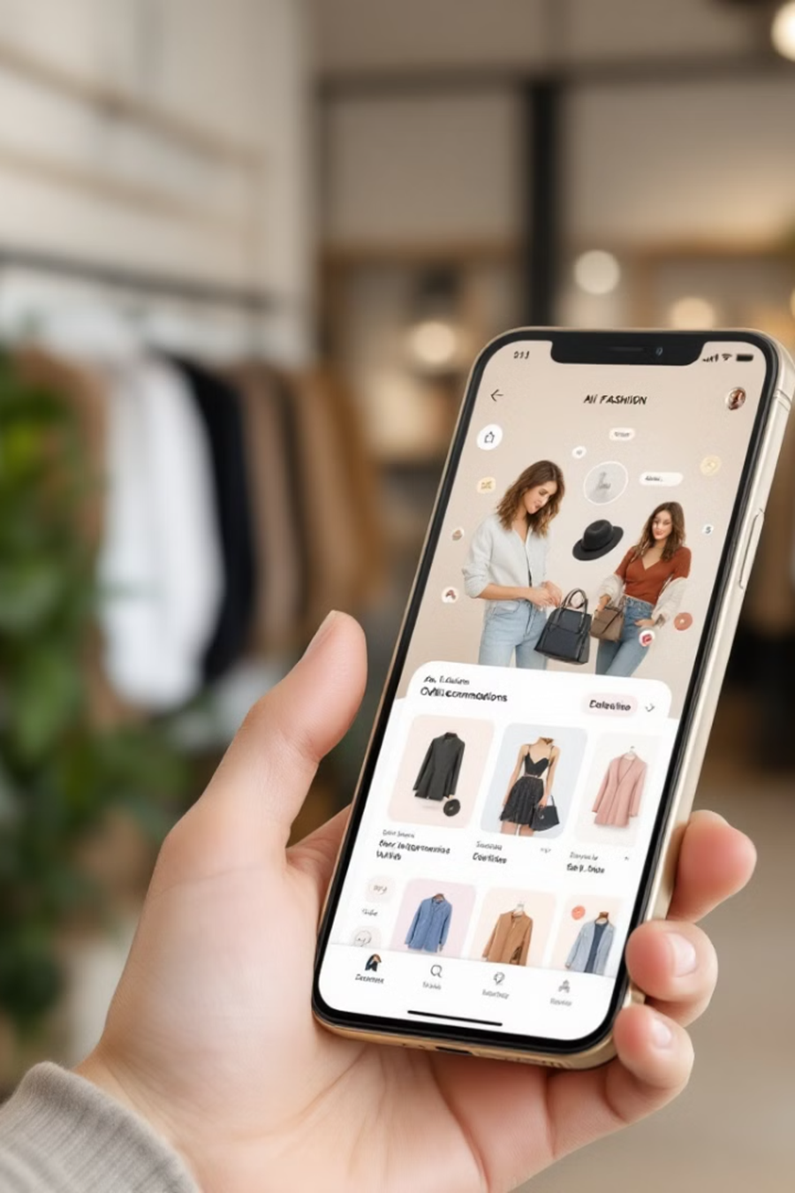
fAIshion: The Smart Way of Shopping
AI-powered shopping assistant that enhances retail experience with personalized outfit recommendations.

Slide 2
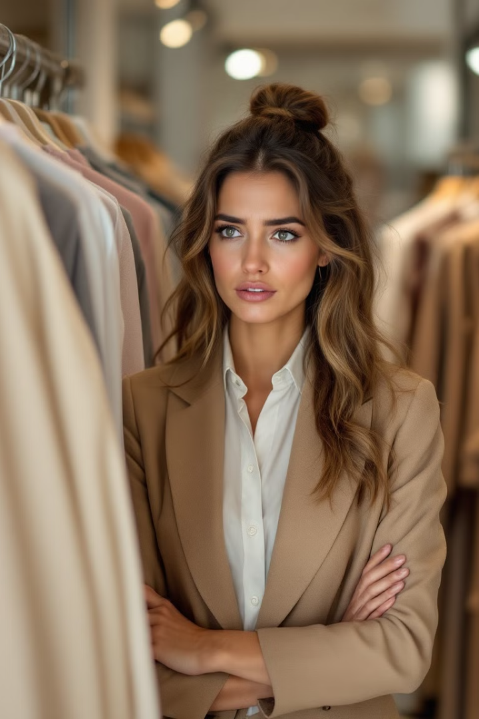
The Problem
Time-Consuming
Decision Making
Trying on clothes can be time-consuming, inconvenient, and often frustrating for shoppers.
Many shoppers struggle with choosing and coordinating outfits due to uncertainty in style combinations and suitability.
Returns Issues
Approximately 30% of online fashion purchases are returned due to sizing and fit issues

Slide 3
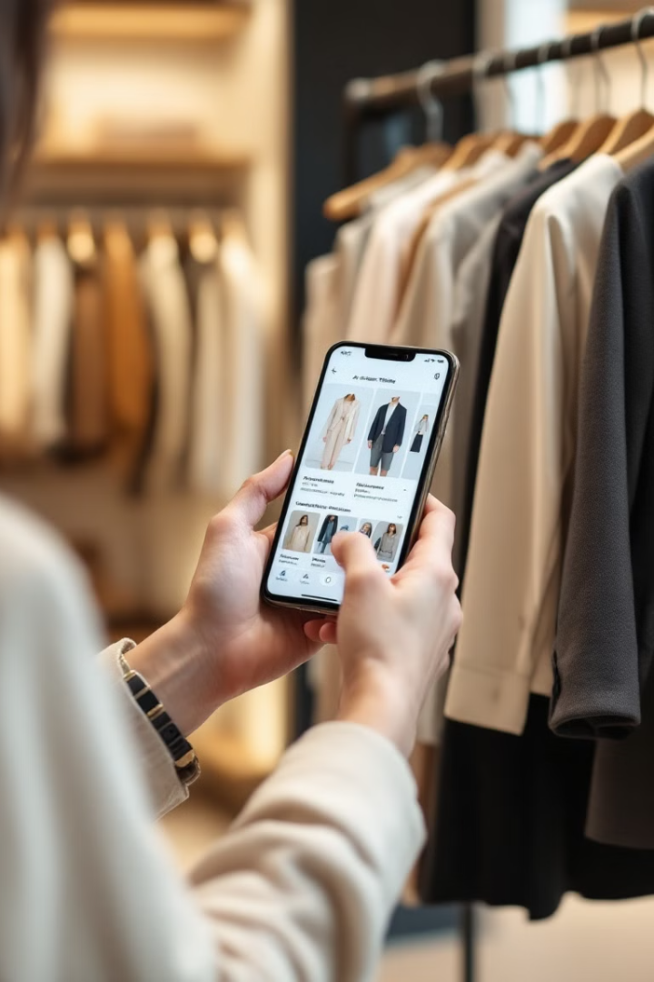




fAIshion Solution
Scan Items using QR Code
Use QR codes or barcodes to seamlessly add products to a virtual wardrobe for
easy access and future purchases.
AI Recommendations
Receive personalized outfit recommendations tailored to your style preferences, body type, and specific occasions.
Location Tracking
5G technology enables real-time store location detection
Digital Wardrobe
Mix and match in-store items with pieces from your existing wardrobe

Slide 4




Technology Behind fAIshion
Computer Vision
1
Identifies and analyzes clothing attributes from images.
Natural Language Processing
2
Understands and processes text-based outfit requests.
Database & Cloud Storage
3
Stores and categorizes user's fashion trends and clothing data.
Retailer's API
4
Provides product availability and pricing from retailers.

Slide 5
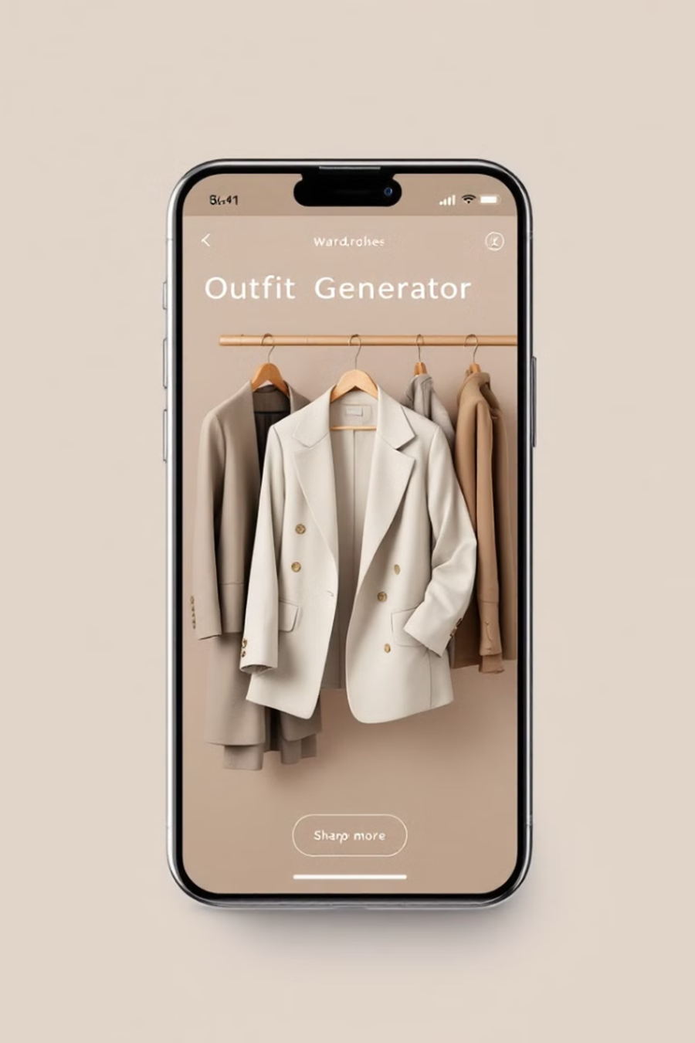
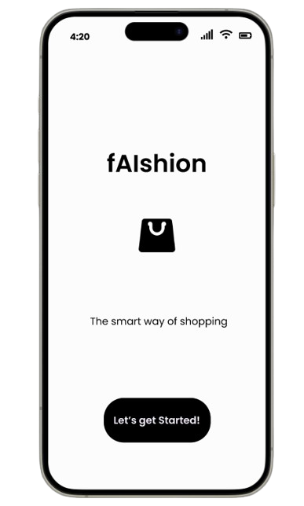
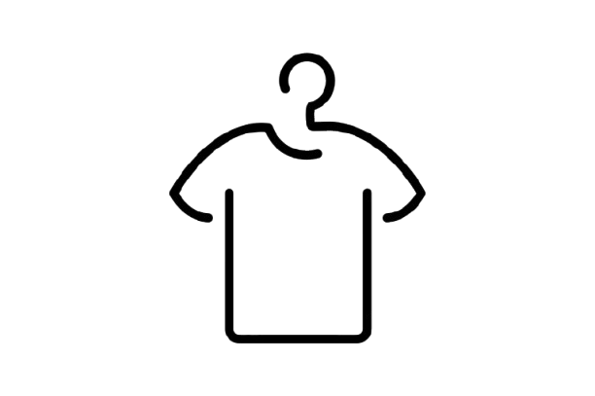



Key Features
e-Wardrobe
Smart Scanning
Digital inventory of all your clothing items.
Add items to your collection with a simple QR scan.
Store Locator
Outfit Generator
Find nearby stores with 5G Technology
AI tailored outfits for every occasion

Slide 6
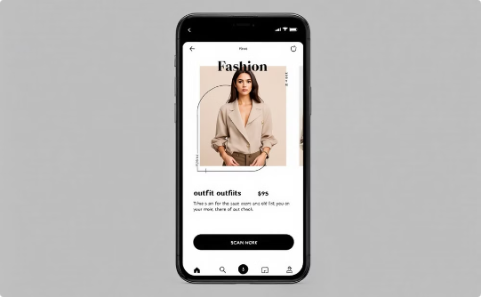
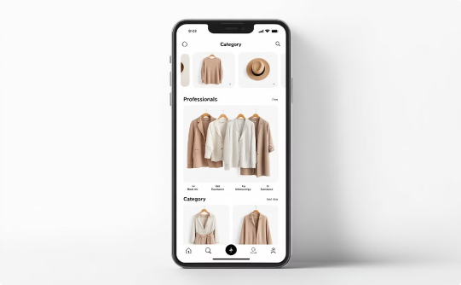
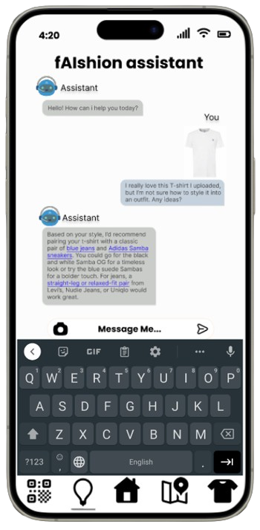
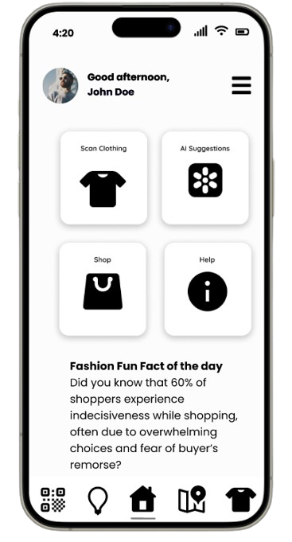
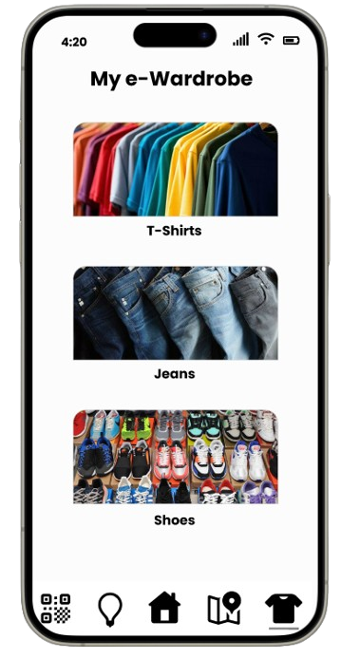
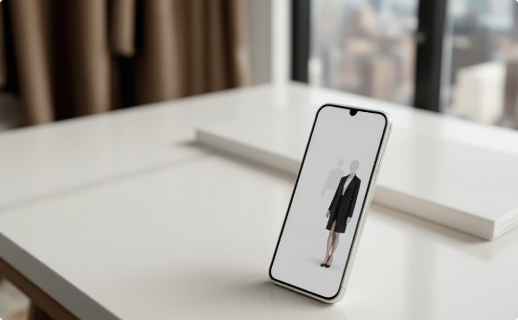
App Interface
Home Screen
e-Wardrobe
Outfit Generator Chat
Main hub for scanning, suggestions, store location.
Digital collection of scanned or purchased items.
AI-powered outfit recommendations

Slide 7




Business Model
Free Mobile App
1
Subscription Model
Available on Android and iOS
2
Ad-free with unlimited personalized fashion recommendations
Data Insights
4
Retailers and Brands
3
Real-time trends and statistics via APIs for third-party integration
Retailers and brands advertisement and promotional model

Slide 8
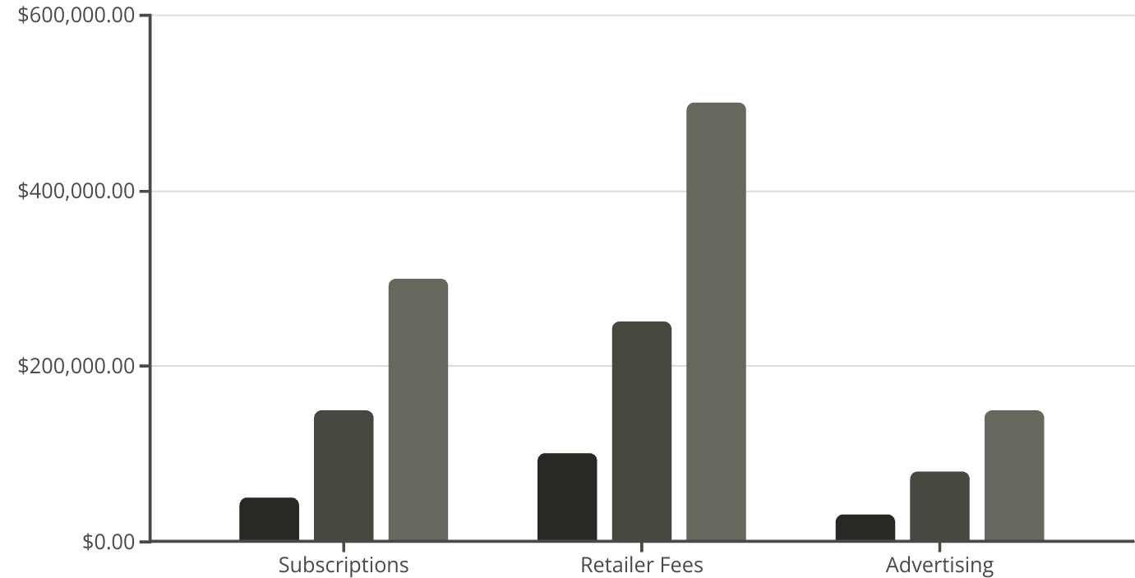
Market Potential
Year 1
Year 2
Year 3

Slide 9

Our Team

Slide 10
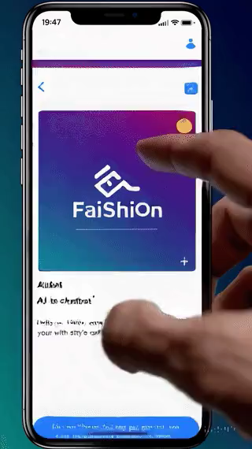
Thank you
Do you have any questions?

